Slide 1
DS6030 25Sp Statistical Learning
Disaster Relief Project-Part 2
DS-6030 – Group 12
Ampoyo, Rheyan (xcs5hg)
Belle, Camisha L. (fbv2ub)
Cuevas Rodriguez, Dalila (zfd9aj)
Tran, Karmen Victoria (aqq2ex)
Notes:
Welcome to Group 12's presentation of the University of Virginia's School of Data Sceince's Disaster Relief Project in fulfillment of the requirements for the DS6030 Statistical Learning class. Group 12 consists of Rheyan Ampoyo, Camisha Belle, Dalila Cuevas Rodriguez, and Karmen Tran.

Slide 2
Introduction
Notes:
Introduction
No notes from Vish for the Intro section, but see below for his notes related to the coding: Coding:
Good Documentation and structure in the RMD Code
There is a lot of manual normalizing of the columns, you can streamline it by first appending all similar data together and then do the transformation altogether.
The Holdout Dataset has B1,B2,B3 as columns instead of R,G,B. There is no discussion to why these were mapped directly. If the order of B1/B2/B3 was altered, all the evaluations would have been wrong.
For formula, you can directly use Outcome Variable ~ ., no need to extract the formula by first fitting a glm model and then using it.

Slide 3

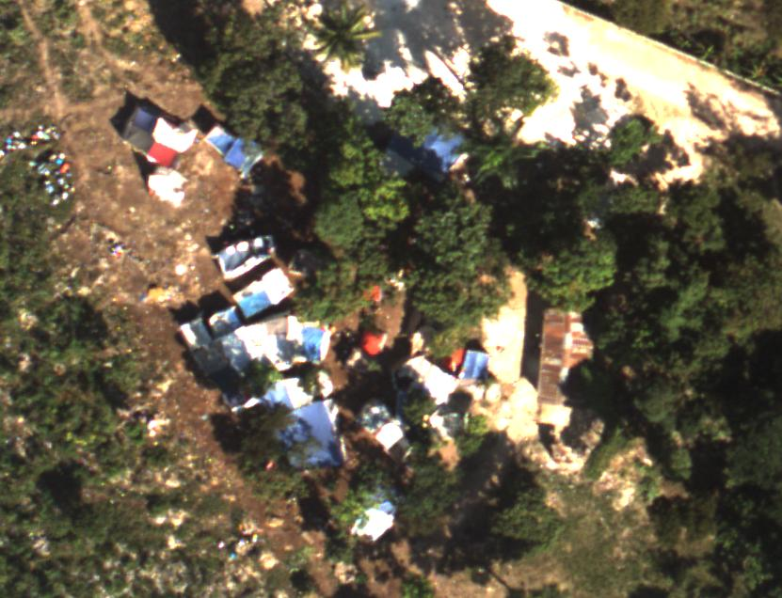
2010 earthquake spurs historic data-mining challenge
January 12, 2010: Haiti earthquake
Humanitarian aid operational challenges
Data‑mining need to address obstacles
https://www.unocha.org/sites/unocha/files/dms/Documents/Evaluation%20of%20OCHA%20Response%20to%20the%20Haiti%20Earthquake.pdf.
Notes:
On January 12, 2010, a magnitude 7.0 hit Haiti devastating Port‑au‑Prince. Approximately 230,000 people were killed, 300,000 injured, and 1.5 million displaced. Critical infrastructure was destroyed.
Humanitarian aid agencies faced major operational challenges due to destroyed communication systems and roads hampering relief delivery.
Rochester Institute of Technology (also known as RIT) teams collected geo‑referenced images using aerial photography. The imagery revealed that displaced individuals, whose homes were destroyed, were using blue tarps to construct temporary shelters.
Manually locating blue tarps among thousands of images was infeasible, the solution to this challenge was to us data-mining algorithms. So, statistical learning algorithms were employed for efficient identification of people in need of assistance.
Group 12's project goal is to use methods learned in UVA’s Data Science 6030 course to build and evaluate multiple models to optimize displaced‑person detection.

Slide 4
Data
Exploratory Data Analysis
Notes:
We will suspend discussion of the basic attributes of the dense training and holdout data sets provided for this exercise and move directly into talking about core features of the data used to identify the blue tarps in the aforementioned images.
Vish's notes
Layered Density Plots is a good idea, additionally boxplots to supplement the differences is helpful.
The color coded scatter plot is really innovative.

Slide 5
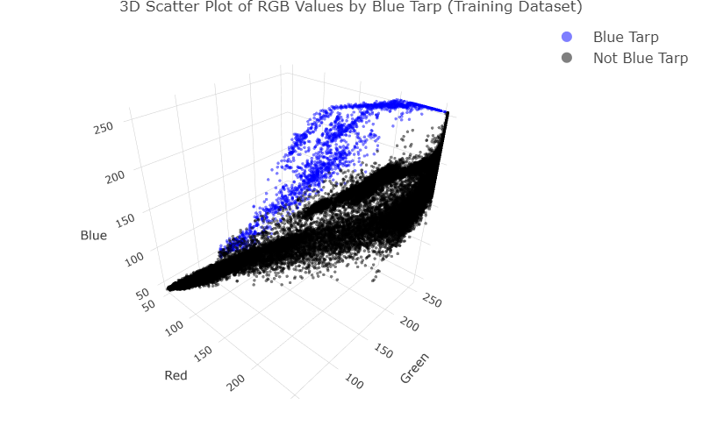
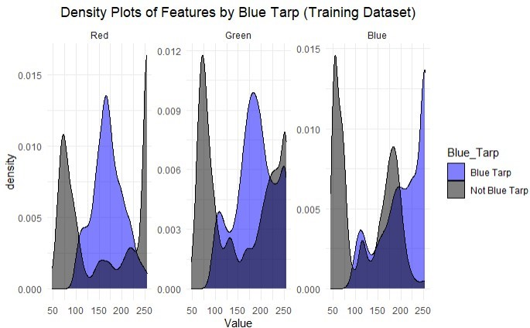
Training Dataset
Notes:
To determine the location of blue tarps in RIT’s images, Group 12 transformed the "Class" response variable into a bivariate output. The new variable was assigned a value of "Blue Tarp" for observations with a class of "Blue Tarp" (n = 2,022; 3.2%) with all other values coded as "Not Blue Tarp" (n = 61,219; 96.8%). T-tests indicate that all three features ("Blue", "Green", and "Red") have statistically significant differences between the binary “Blue_Tarp” classes.
After transformation, the color values remain highly effective in distinguishing between the categories as displayed in this 3D scatterplot.

Slide 6
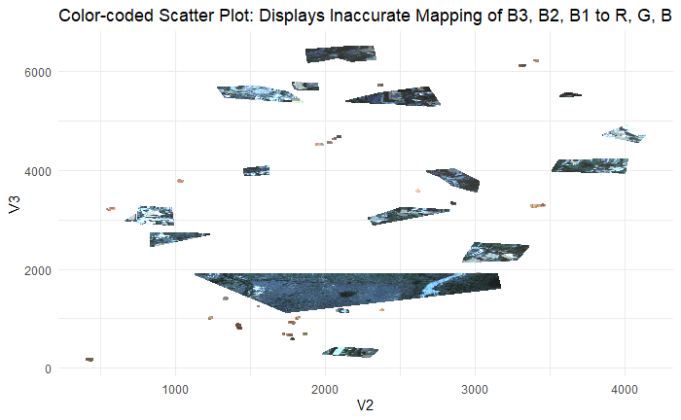
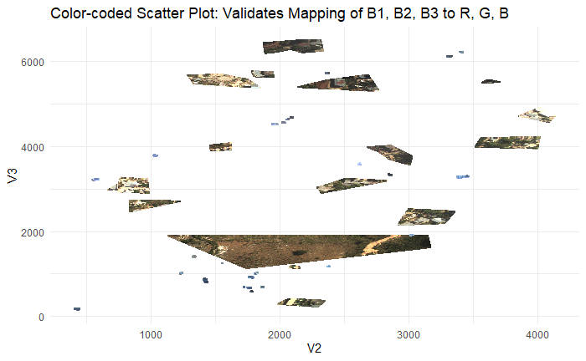
Test Dataset
Group 12 created an RGB calculator to explore the 6 permutations of B1, B2, and B3 comparing the results visually using a scatter plot of images provided in the holdout data.
Notes:
The holdout dataset was comprised of eight individual text and three JPG image files.
The holdout dataset, which contains 2,008,623 observations, also includes a categorical variable called "Class". Like the training dataset, this data does not contain any missing values. Unlike the training dataset, this variable already classified the data as either “Blue Tarp” (18,926 observations representing only 0.94% of the data) or “Not Blue Tarp” (1,989,697) with no further transformation needed.
After exploring all possible RGB color combinations using an RGB calculator, we determined that interpreting column 8 (B1) as Red, column 9 (B2) as Green, and column 10 (B3) as Blue produced scatterplots with colors that closely matched those provided in example images. The other 5 permutations resulted in unnatural hues of green, purple, or turquoise, indicating an incorrect mapping of the color channels.
It is important to note that the position of the figures in the plot was not a factor in our analysis; this approach was solely used to verify the correct order of the RGB channels.
After data preparation, including applying factors to the Class output variable, the team was ready to proceed with its analysis.

Slide 7

Description of Methodology

Slide 8

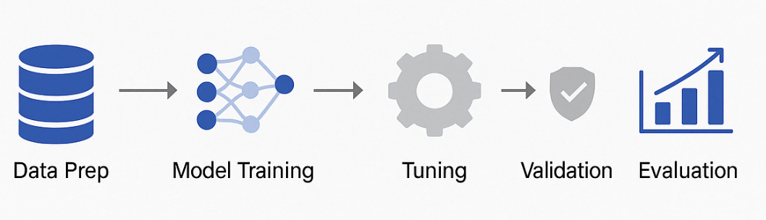
Methodology Overview
Conducted in using tidymodels framework
Modular pipeline for reproducibility and scalability
Used Microsoft Word to work collaboratively on written report
Goal: Predict blue tarp presence using supervised classification
Notes:
Dalila
For this project, we used R as our primary tool, specifically leveraging the tidymodels framework.
This allowed us to create a modular and reproducible workflow, making it easier to manage preprocessing, modeling, and evaluation steps consistently across models.
To document our work and collaborate effectively, we used Microsoft Word for the final report.
Our modeling task was framed as a supervised classification problem, with the goal of predicting the presence of blue tarps in aerial imagery following a disaster.
As you can see in the visual, our pipeline moved systematically from data preparation through evaluation, ensuring that each phase was well-defined and repeatable.

Slide 9
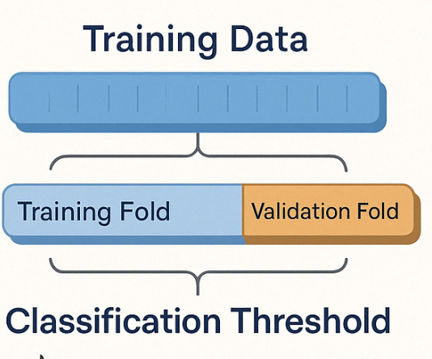
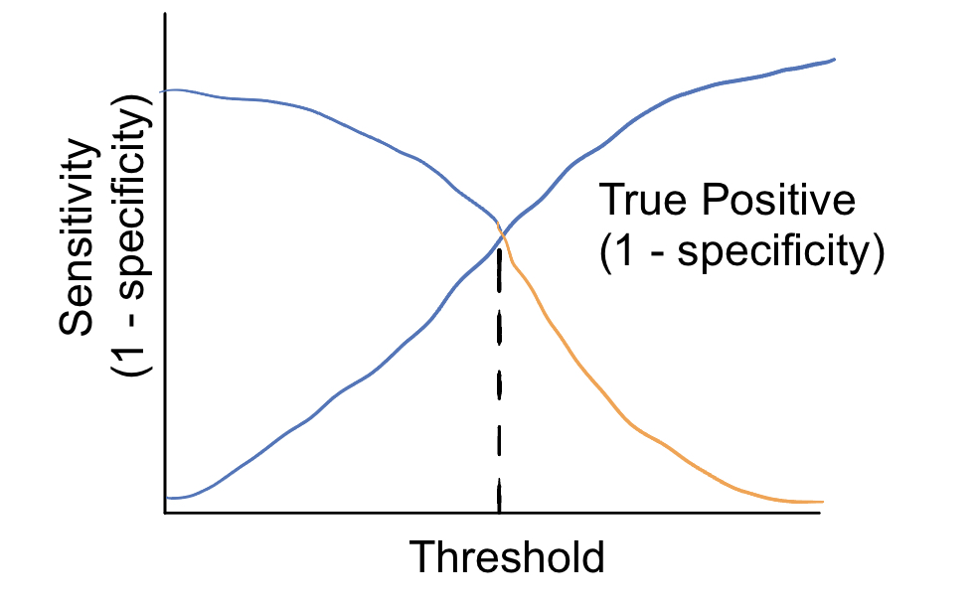

Model Development & Validation Strategy
10-fold stratified cross-validation used on training data
Ensures all samples used for training and validation
Stratification preserved class imbalance (blue tarp = minority class)
Final evaluation on separate holdout test set
Notes:
Dalila
To train and validate our models, we applied 10-fold stratified cross-validation to the training data.
This method was chosen because our dataset was imbalanced, meaning the blue tarp class was underrepresented.
Stratification helped ensure that each fold preserved the class proportions, reducing bias and improving the model’s ability to generalize.
After cross-validation, we evaluated final model performance using a holdout test set, which was never seen during training.
We also optimized the classification threshold based on the ROC curve and AUC, which I’ll explain further in the next slide.

Slide 10
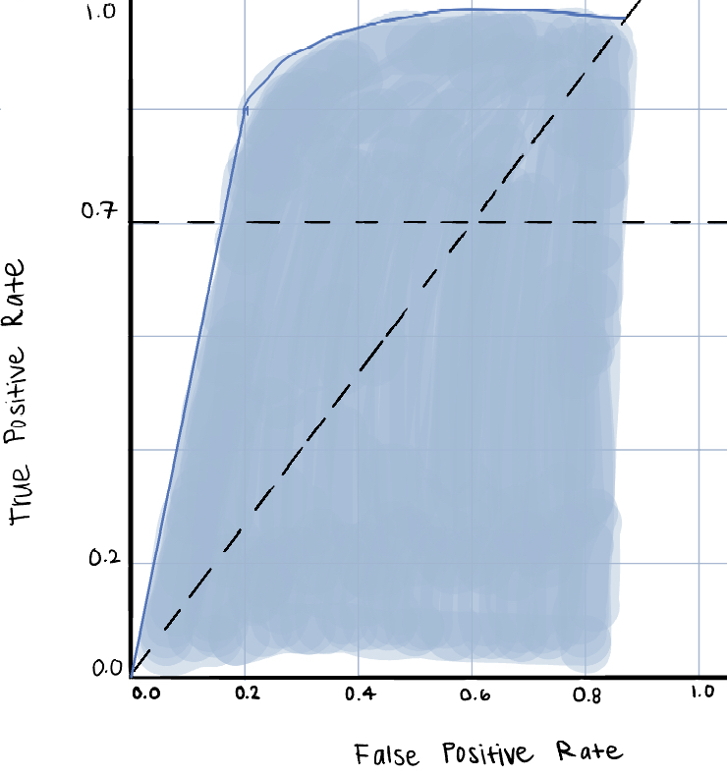
Threshold Selection
Choice of classification threshold in study optimized based on ROC curve and AUC
Threshold adjusted to balance True Positive Rate (TPR) and False Positive Rate (FPR)
Threshold of 0.7 chosen for most models
Notes:
Dalila
The classification threshold plays a critical role in how our model balances between sensitivity and specificity.
To determine the best threshold, we examined the ROC curve and calculated the Area Under the Curve, or AUC.
We looked for a point on the curve that gave us a strong True Positive Rate while keeping the False Positive Rate low.
Based on this analysis, we selected a threshold of 0.7, which offered the best trade-off for most of our models.
This choice helped us reduce false positives, which is especially important in disaster response scenarios, where misidentification could lead to wasted resources.

Slide 11

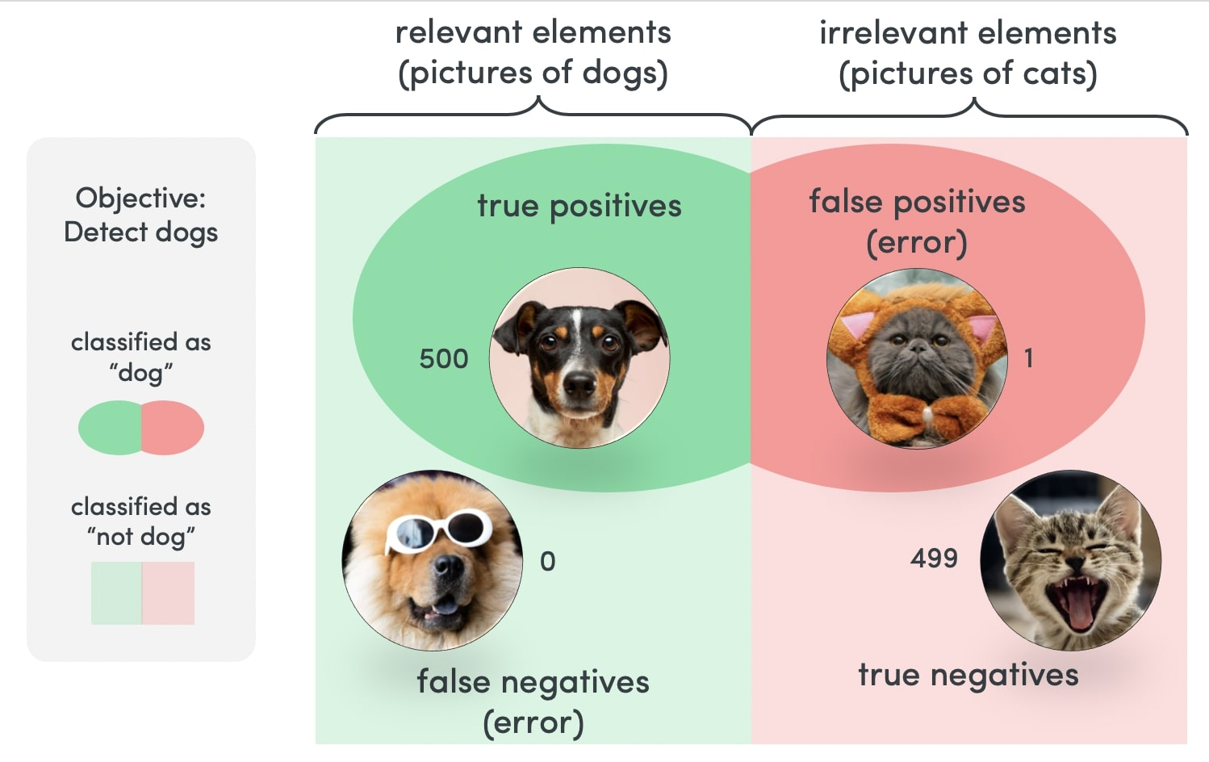
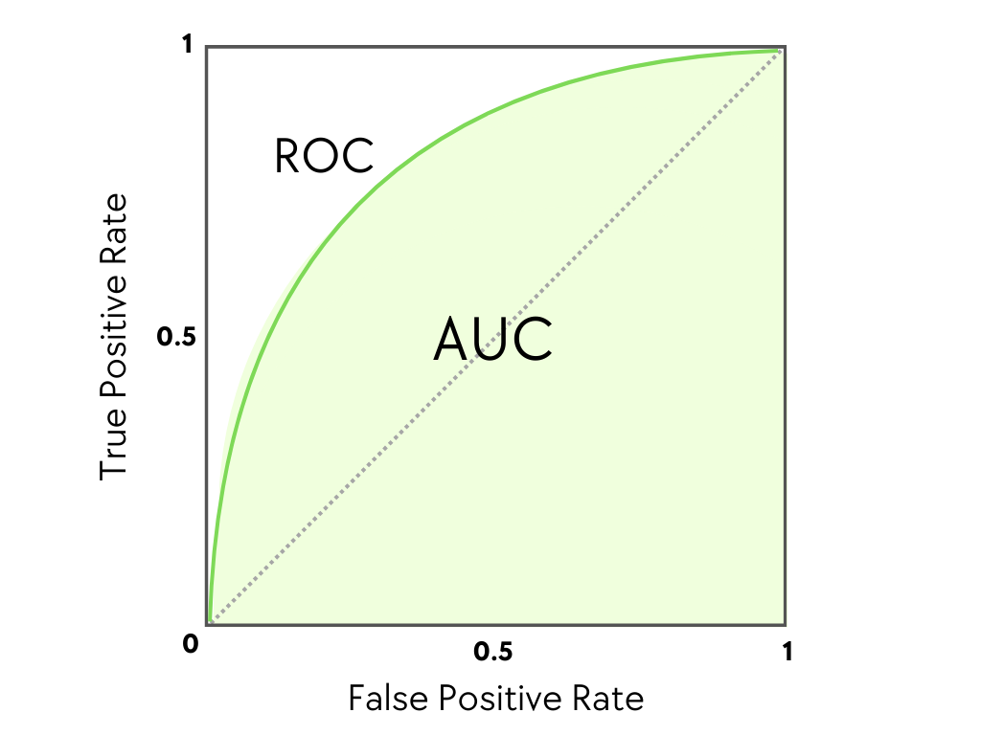
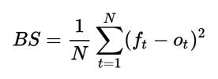
Model Evaluation Metrics
Accuracy: Overall correctness of predictions
Brier Score: Penalizes overconfident wrong predictions
AUC-ROC: Distinguishes between classes across thresholds
Precision: Minimizes false positives (important in disaster response)
TPR (Recall): Captures all actual positives (blue tarps)
FPR: Avoids triggering false alarms
*Note: Metrics were selected to align with real-world impact priorities, especially in emergency contexts.
Notes:
Dalila
To comprehensively evaluate model performance, we relied on a range of metrics:
First, accuracy gives us a baseline idea of how often the model was correct.
But because our dataset is imbalanced, we also used Brier Score to evaluate the quality of probability predictions, and AUC-ROC to measure how well the model distinguishes between classes.
Precision was key for minimizing false positives, and True Positive Rate—or recall—helped ensure we didn’t miss actual cases of blue tarps.
We also tracked False Positive Rate to keep an eye on how many negative cases were incorrectly flagged.
Together, these metrics gave us a well-rounded view of how our models would perform in real-world conditions.

Slide 12
Results
Notes:
Vish's note: Well detailed Results section

Slide 13

Results Preview
How did we quantify the performance of our models?
Sensitivity
Why did we choose sensitivity for our metric?
Class Imbalance
Note, all models were tuned (if possible) to their optimal tuning parameters so each model is at their best form
Notes:
Before diving into the results, it's important to know how we quantified the performance of each model, we looked at metrics such as roc_auc, accuracy, sensitvity and specificity. We ended up choosing to use sensitivity as our main metric in measuring each models' performance.
This is due to the concept of class imbalance, there were far many labels for non-blue tarps than there were for blue tarps. Therefore, it wouldn't be appropriate for us to settle on accuracy or roc_auc as our metric. Hence, why we looked to sensitivity which shows us our models' efficacy on detecting true positives.
We mentioned earlier that we wanted to maximize our True Positive Rates due to the nature of the data. Remember, we're looking to find survivors of the Earthquake who resided in blue tarps so its important to that we choose our models to have high true positive rates so that we don’t misclassify blue tarps in the given photos.
Also, all models were tuned (if possible) to their optimal tuning parameters ensuring that each model performed at their best for this dataset

Slide 14
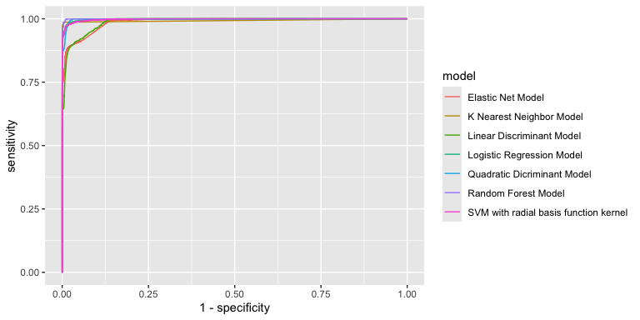
ROC Curve Visualization
Notes:
Here is a visualization comparing the roc curves of all the models which gives a general idea of how well a classification model performs. Here, we can see that there are two models that do not perform as well as the others according to the ROC curve which are the K Nearest Neighbor Models and the Linear Discriminant Model
It should be noted that even though those two models don't perform as well as the others, all of the models still do relatively well as any roc auc score above .8 is generally considered good and we will go more in depth about each models roc_auc scores in the next slide.

Slide 15
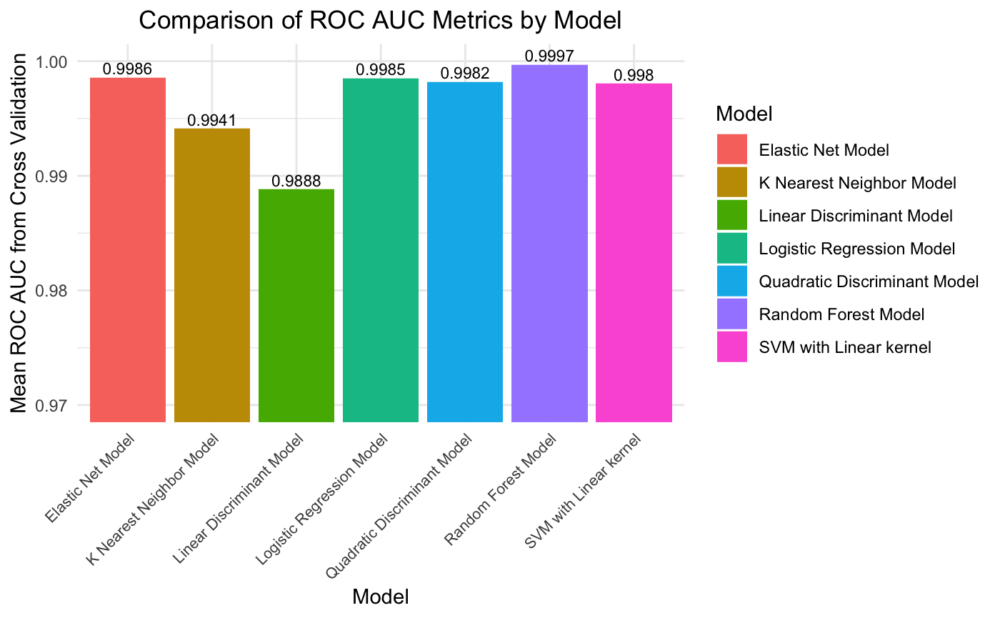
Comparison of Models
Easier visual for roc auc's
Notice y-axis tick labels
All roc auc's are very good!
Just not necessarily what we are looking for
After optimizing the tuning parameters for each model, we see that the Random Forest Model has the highest mean roc auc's of all the models
Optimal Random Forest Parameters
mtry = 0
trees = 36
min_n = 8
Notes:
Here is an easier visual for the numerical values of roc auc scores. We can see more definitively that the K Nearest Neighbor and Linear Discriminant Models have the lowest scores. This is not to say that the models were bad but rather the K Nearest Neighbor and Linear Discriminant Models did not perform as well as the other five models we trained. The roc curve is a visual representation of trade off between sensitivity and specificity of a model (More on what this means for the results). The roc auc score measures how well a model can produce relative scores to discriminate between positive or negative instances across all classification thresholds. In this case Blue Tarp and Non Blue Tarp Labels.
It's also important to note that the plot has its y axis restricted to a limit of .97 to 1 to make it easier to see the very small difference of roc auc scores of each model
All of these models were tuned for their optimal parameters, so each of these models should be the 'best' version of themselves for this specific dataset.
After tuning, IF we were using roc auc as our metric to choose the best model it turns out that the random forest model performed the best in regard to this dataset

Slide 16
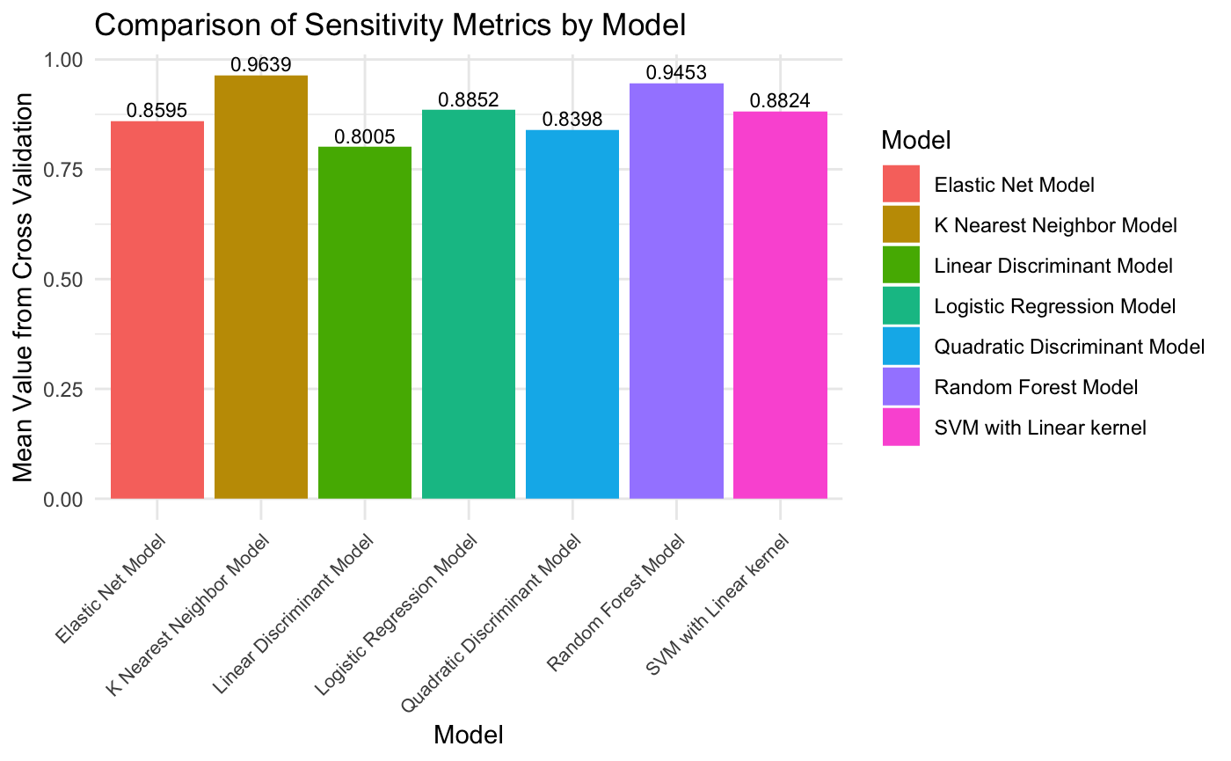
Comparison of Models
True Positives are extremely important to catch!
After optimizing the tuning parameters for each model, we see that the K Nearest Neighbor Model has the highest mean Sensitivity of all the models
Optimal K-Nearest Neighbor Parameters
K = 16
Notes:
Recall in the last slide I stated "Its important that we choose our models to have high true positive rates so that we don’t misclassify blue tarps in the given photos". In other words, we want to choose the model that had the highest sensitivity so our chosen model has the most correctly classified labels for blue tarps.
However this comes at a cost as I also mentioned that the roc curve represents the trade-off between the sensitivity and specificity of a classifier model. So, we are not just choosing the model with the best sensitivity for 'free'. We are instead trading how well a model classifies true negatives.
In this case, we don’t really care about true negatives as much as the true positives for this data set. Remember, we are trying to locate where the blue tarps are in order to save the lives of earthquake victims, were not too concerned about the areas that don't have blue tarps while yes, in context, this may cost us money and resources but that is a conversation for another time.
With this in mind, we look to choosing the model that has the highest sensitivity.
Even though this model had one of the lower roc auc scores, the K Nearest Neighbor Model turns out to have the highest sensitvity!

Slide 17
Conclusions

Slide 18
Conclusion #1: Logistic Regression Outperforms LDA and QDA.
Conclusion #2: Enhance Logistic Regression with Regularization and Ensemble Models.
Conclusion #3: K-Nearest Neighbor Performs Best using Cross-Validation and the Holdout Data.
Conclusion #4: The Findings Between Cross-Validation and Holdout is a Reconcilable Outcome.
Conclusion #5: K-Nearest Neighbor Model should be used for the Detection of Blue Tarps.
Conclusion #6: Accuracy, ROC AUC, Sensitivity, and Specificity are Essential to Blue Tarp Detection.
Notes:
Vish's note: Conclusion 3 is not a project based conclusion from the work done but something like the introduction paragraph.
Conclusion #1: Logistic Regression Outperforms LDA and QDA.
Finally, we found that Logistic Regression, while often considered a simpler model, actually outperformed more complex ones like QDA and LDA on the hold-out data. Its low false positive rate and near-perfect precision make it ideal for reliable tarp identification. And, by introducing regularization or even ensemble enhancements, we could make it even more robust and adaptive to varying conditions and data sources.
Conclusion #2: Enhance Logistic Regression with Regularization and Ensemble Models.
To further enhance the performance of Logistic Regression—which already outperformed other models on the hold-out dataset—we recommend a few key improvements. First, incorporating regularization techniques like L1 or L2 penalties can help reduce overfitting and improve generalization, especially in varying lighting conditions that affect color data. Second, ensemble methods such as Random Forest or Boosting could be explored to capture more complex patterns and improve overall robustness. We also suggest leveraging spatial and geospatial features, such as map coordinates, to boost classification accuracy and uncover potential clustering in tarp locations. Lastly, fine-tuning the model’s probability threshold could help increase true positive detections without significantly raising false positives. Together, these strategies can make Logistic Regression even more accurate, reliable, and ready for real-world disaster response.
Conclusion #3: K-Nearest Neighbor Performs Best using Cross-Validation and the Holdout Data.
Let's start by looking at performance across different evaluation phases. During cross-validation, the K-Nearest Neighbor model performed the best in terms of sensitivity, with a mean score of about 96%. This means it was the most successful at identifying true positive cases which is especially important for tasks like detecting blue tarps, where missing a real tarp could be costly. On the other hand, the Random Forest model had the highest ROC AUC score, just under 1, indicating outstanding ability to separate classes overall. While it didn’t outperform KNN in sensitivity, its high AUC suggests it might generalize better when applied to new, unseen data potentially making it the more stable performer on hold-out data.
Conclusion #4: The Findings Between Cross-Validation and Holdout is a Reconcilable Outcome.
KNN excels in sensitivity, meaning it aggressively captures all true positives but it can be prone to overfitting, especially with smaller datasets. This might inflate its cross-validation score without translating as well to hold-out performance. In contrast, Random Forest leverages ensemble learning, making it more stable and generalizable. Its AUC score reflects this strength in broad classification performance. So even though each model excels in a different metric, they’re both doing exactly what they’re built to do and their performance is consistent with their design.
Conclusion #5: K-Nearest Neighbor Model should be used for the Detection of Blue Tarps.
Now let’s talk about which model we’d actually recommend for blue tarp detection. In this scenario, we care most about sensitivity catching every possible instance of a blue tarp. Missing one could mean overlooking a location that needs emergency aid or disaster response. Given that, the K-Nearest Neighbor model with K set to 16 is our top pick. It may not be the most balanced model overall, but it’s the best at what matters here: not missing a positive case. In this context, a few false alarms are okay missing an actual tarp is not.
Conclusion #6: Accuracy, ROC AUC, Sensitivity, and Specificity are Essential to Blue Tarp Detection.
The metrics we used accuracy, sensitivity, specificity, and ROC AUC are all highly relevant to this context. Sensitivity ensures we don't miss actual tarps; specificity prevents false alarms. ROC AUC helps us assess overall discrimination ability. These aren’t just academic measures they directly impact life-saving decisions in high-pressure environments, guiding where emergency aid goes and when.
In conclusion, our analysis shows the importance of model evaluation across multiple dimensions. Whether it’s through generalization, interpretability, or real-world readiness, our goal remains the same: to build tools that help save lives, quickly and accurately.
Thank you.

